Slide 1
Peer Programming Task: Topic 3
Ujjwal Dhakal
Tanisha Mina Oishi
Reuben Anning
Mahdi Ul Ruddro

Slide 2
Github Repository Link
https://github.com/Ujjwal-D/Peer-Programming-Defensive-Technology

Slide 3
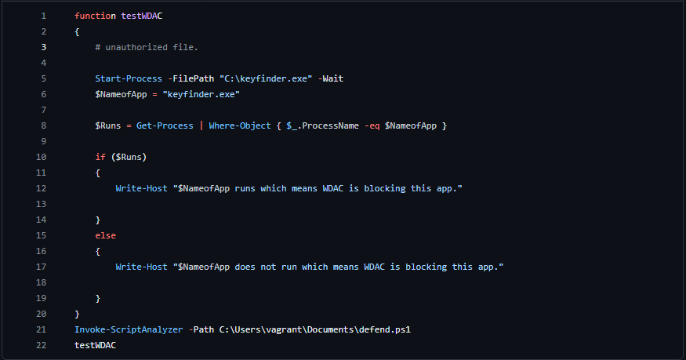
Function testWDAC()

Slide 4
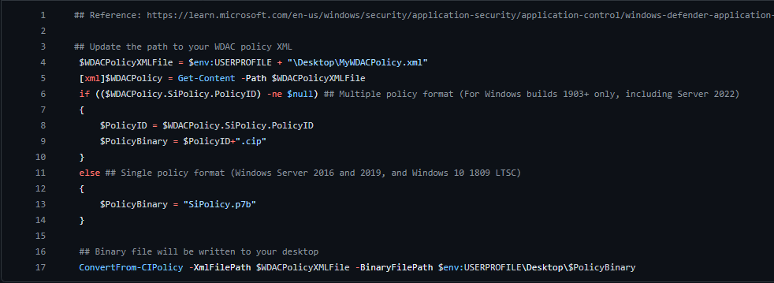
Function setupWDAC() w/ added code to check first argument of command line

Slide 5
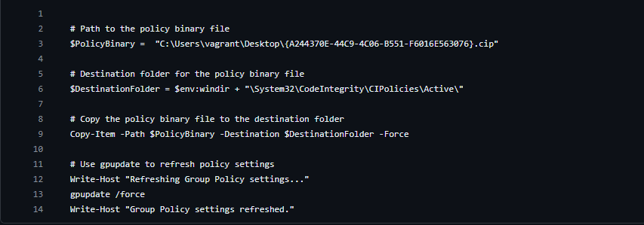
enableWDAC()

Slide 6
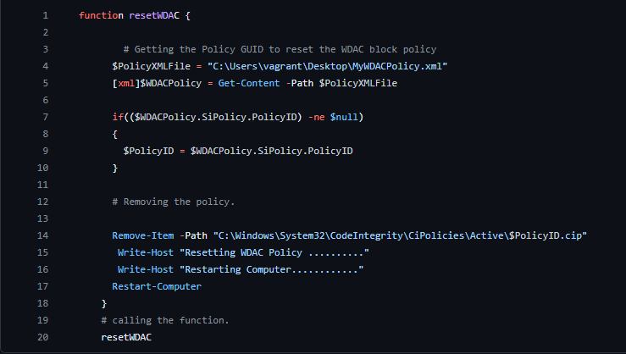
resetWDAC()

